Slide 1
Intro to Python Graphics
+

Slide 2
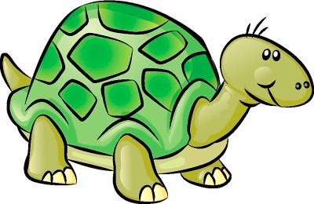
⁺ Hello, Turtle Graphics!

Slide 3
⁺ Turtle Graphics
Turtle graphics is a method of programming “vector” graphics using a relative cursor upon a Cartesian plane
Python has a built in module that supports turtle graphics called the “turtle” module. Importing this module gives you access to all the turtle graphics functions you will need to draw vector graphics on the screen.
In turtle graphics you control a cursor, also know as a “turtle”. It has the following properties
A position in 2D space
An orientation, or heading
A pen that can lay down color on the canvas

Slide 4
⁺ Setting up your turtle environment
import turtle
# set a title for your canvas window
turtle.title(”My Awesome Turtle Animation")
# set up the screen size (in pixels - 425 x 425)
# set the starting point of the turtle (0, 0) turtle.setup(425, 425, 0, 0)

Slide 5
⁺ IMPORANT NOTE!
Do not name your Python source code file “turtle.py”
This will prevent Python from finding the correct “turtle.py” module when you use the “import turtle” statement at the top of your program

Slide 6
⁺ Getting rid of the turtle window
This function call will cause your turtle window to deactivate when you click on it. Place it at the end of your program.
turtle.exitonclick()

Slide 7
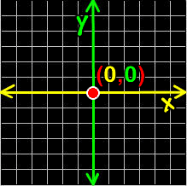
⁺ The Turtle Canvas

Slide 8
⁺ Basic Drawing
You can move your turtle forward by using the following command:
turtle.forward(pixels)
And you can have your turtle turn by using the following commands:
turtle.right(degrees) turtle.left(degrees)
Your turtle will continually “paint” while it’s moving.

Slide 9
Turtle Methods
METHOD | PARAMETER | DESCRIPTION
Turtle() | None | Creates and returns a new tutrle object
forward() | amount | Moves the turtle forward by the specified amount
backward() | amount | Moves the turtle backward by the specified amount
right() | angle | Turns the turtle clockwise
left() | angle | Turns the turtle counter clockwise
penup() | None | Picks up the turtle’s Pen
pendown() | None | Puts down the turtle’s Pen
up() | None | Picks up the turtle’s Pen
down() | None | Puts down the turtle’s Pen

Slide 10
color() | Color name | Changes the color of the turtle’s pen
fillcolor() | Color name | Changes the color of the turtle will use to fill a polygon
heading() | None | Returns the current heading
position() | None | Returns the current position
goto() | x, y | Move the turtle to position x,y
begin_fill() | None | Remember the starting point for a filled polygon
end_fill() | None | Close the polygon and fill with the current fill color
dot() | None | Leave the dot at the current position
stamp() | None | Leaves an impression of a turtle shape at the current location
shape() | shapename | Should be ‘arrow’, ‘classic’, ‘turtle’ or ‘circle’

Slide 11
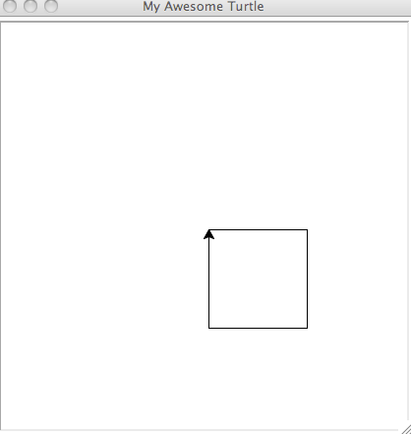
⁺ Programming Challenge: Draw a Box!
import turtle
skk = turtle.Turtle()
for i in range(4):
skk.forward(50)
skk.right(90)
turtle.done()

Slide 12
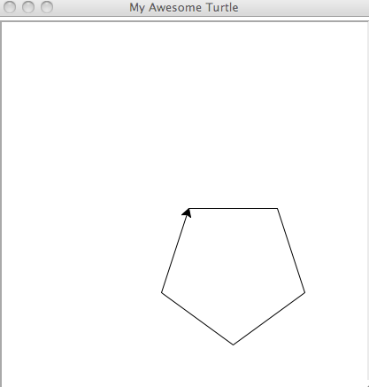
⁺ Programming Challenge: Draw an Pentagon!
import turtle
pentagon = turtle.Turtle()
num_sides = 5
side_length = 70
angle = 360.0 / num_sides
for i in range(num_sides):
pentagon.forward(side_length)
pentagon.right(angle)
turtle.done()

Slide 13
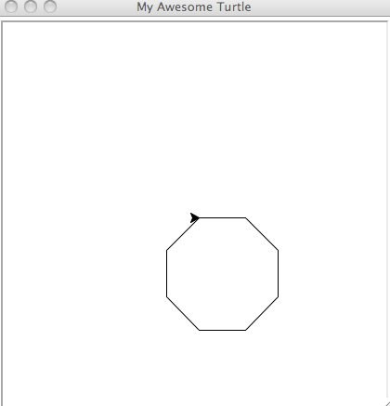
⁺ Programming Challenge: Draw an Octagon!
import turtle
octagon = turtle.Turtle()
num_sides = 8
side_length = 70
angle = 360.0 / num_sides
for i in range(num_sides):
octagon.forward(side_length)
octagon.right(angle)
turtle.done()

Slide 14
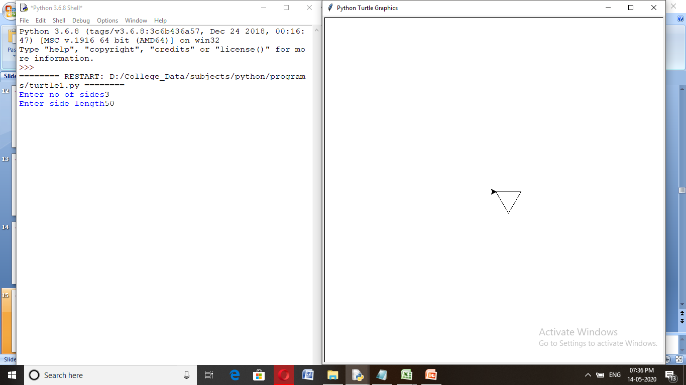
⁺ Programming Challenge: Polygon Function
Write a function that allows you to draw a custom polygon. Your function should take two arguments – the number of sides you wish to draw and the length of a given side.
import turtle
polygon = turtle.Turtle()
num_sides = int(input(“Enter no of sides”))
side_length = int(input(“Enter length of side”))
angle = 360.0 / num_sides
for i in range(num_sides):
polygon.forward(side_length)
polygon.right(angle)
turtle.done()

Slide 15
⁺ Moving your turtle
You can cause your turtle to move to any coordinate on the screen by using the turtle.goto() function along with the x,y coordinate you wish to move to. Example:
turtle.goto(50,50)
Note that your pen will continue to draw as you move your turtle to a new position.
You can tell the turtle to stop drawing by using the turtle.penup() function. You can tell it to start drawing again by using the turtle.pendown() function.

Slide 16
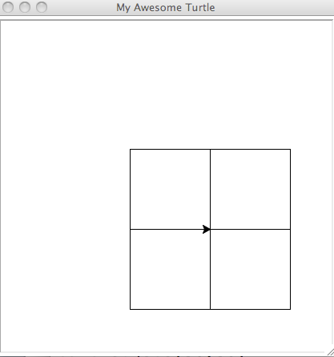
⁺ Programming Challenge: Four Squares

Slide 17
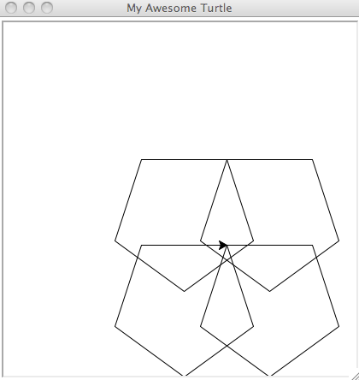
⁺ Programming Challenge: four pentagons

Slide 18
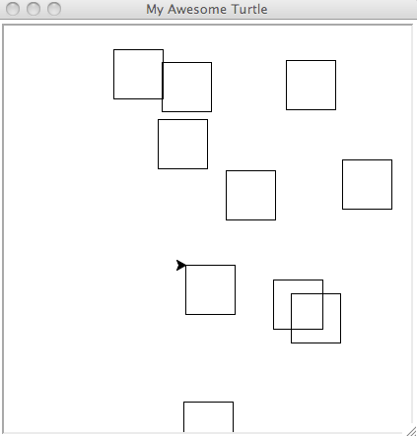
⁺ Programming Challenge: Random Squares

Slide 19
⁺ Pen Color
By default your turtle will draw solid black lines on the canvas
You can change this behavior by calling the turtle.pencolor() function
This function takes one argument – a color value.
The color value can be a standard Red Green Blue (RGB) color code. Here’s an example:
# sets the pen color to red turtle.pencolor(“#FF0000”)
# sets the pen color to blue turtle.pencolor(#0000FF”)

Slide 20
⁺ RGB Color
RGB color codes define how much red, green and blue should be mixed into a given color
They are divided into three channels – one for red, one for green and one for blue, in that order
They usually start with the “#” sign
The first two characters in a color string signify how much red goes into the color
The second two signify how much green
And the third set signifies how much blue

Slide 21
⁺ RGB Color
RGB uses a number system called “hexadecimal”
Hexadecimal (or “hex”) is a base 16 number system. This means it uses 16 “digits” to represent numbers
Counting in hex:
0,1,2,3,4,5,6,7,8,9,A,B,C,D,E,F,10
11,12,13,14,15,16,17,18,19,1A,1B,1C,1D,1E,1F,20

Slide 22
⁺ RGB Color
#000000
# no red, green or blue – all black
#FFFFFF
# full red, green and blue – all white
#FF0000
# all red
#00FF00
# all green
#0000FF
# all blue

Slide 23
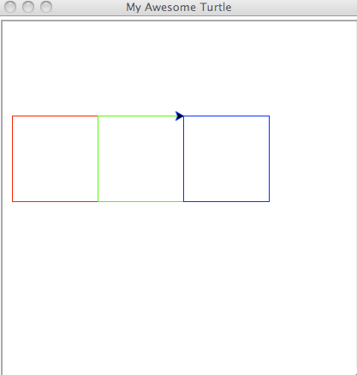
⁺ Programming Challenge: RGB Squares
import turtle
tt = turtle.Turtle()
num_sides = 4
side_length = 50
angle = 360.0 / num_sides
r=50
color=["red","green","blue","black"]
for j in range(0,4):
for i in range(4):
tt.forward(side_length)
tt.right(angle)
tt.penup()
tt.goto(r,0)
tt.pendown()
tt.pencolor(color[j])
r=r+50
turtle.done()

Slide 24
⁺ Creating filled shapes
If you are drawing closed polygons you can tell Python to fill them with an RGB color by calling the turtle.fillcolor() function. This function takes one argument – a color value.
Next, you need to call the turtle.begin_fill() function to tell Python to start filling in your shape. You would call this function just before you start drawing your shape.
At the end of your shape you can use the turtle.end_fill() to tell Python to stop filling in your shape.

Slide 25
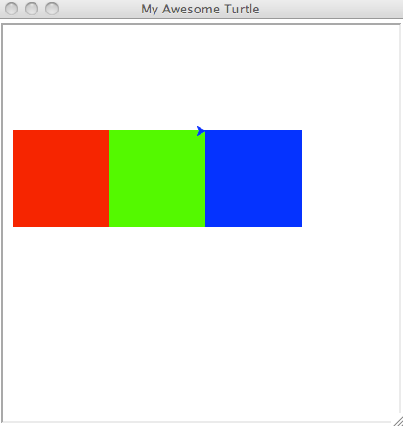
⁺ Programming Challenge: Filled RGB Squares
import turtle
tt = turtle.Turtle()
num_sides = 4
side_length = 50
angle = 360.0 / num_sides
r=50
color=["red","green","blue","black"]
for j in range(0,4):
tt.fillcolor(color[j])
tt.begin_fill()
for i in range(4):
tt.forward(side_length)
tt.right(angle)
tt.end_fill()
tt.penup()
tt.goto(r,0)
tt.pendown()
r=r+50
turtle.done()

Slide 26
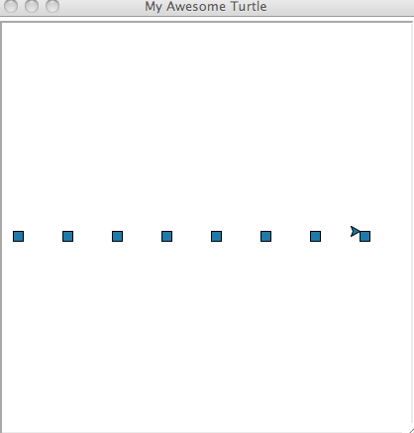
⁺ Programming Challenge: Line of filled squares
import turtle
tt = turtle.Turtle()
num_sides = 4
side_length = 20
angle = 360.0 / num_sides
r=100
incr=100
for j in range(0,6):
tt.fillcolor("blue")
tt.begin_fill()
for i in range(4):
tt.forward(side_length)
tt.right(angle)
tt.end_fill()
tt.penup()
tt.goto(r,0)
tt.pendown()
r=r+incr
turtle.done()

Slide 27
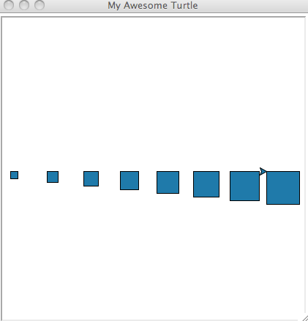
⁺ Programming Challenge: Line of filled squares getting bigger
import turtle
tt = turtle.Turtle()
num_sides = 4
side_length = 20
angle = 360.0 / num_sides
r=50
incr=10
for j in range(0,6):
tt.fillcolor("blue")
tt.begin_fill()
for i in range(4):
tt.forward(side_length)
tt.right(angle)
tt.end_fill()
tt.penup()
tt.goto(r,0)
tt.pendown()
r=r+100
side_length=side_length+incr
turtle.done()

Slide 28
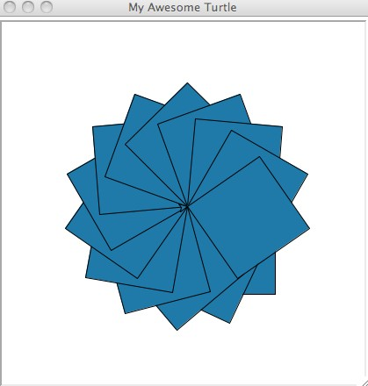
⁺ Programming Challenge: Rotated Filled Squares
import turtle
tt = turtle.Turtle()
num_sides = 4
side_length = 50
angle = 360.0 / num_sides
c=20
r=20
incr=10
for j in range(0,15):
tt.fillcolor("blue")
tt.begin_fill()
for i in range(4):
tt.forward(side_length)
tt.right(angle)
tt.end_fill()
tt.right(r)
turtle.done()

